Slide 1
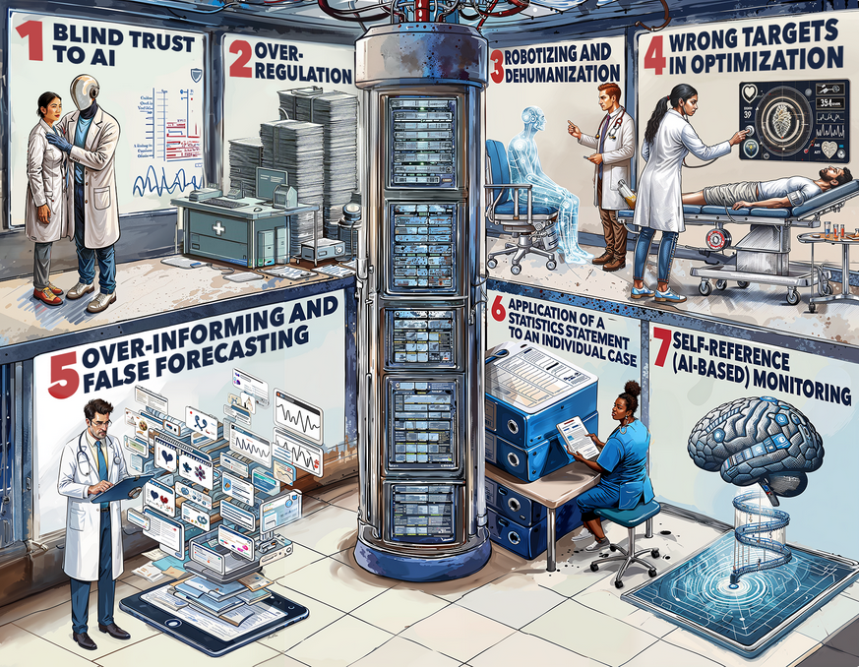
THE SEVEN DEADLY SINS OF AI IN MEDICINE

Slide 2
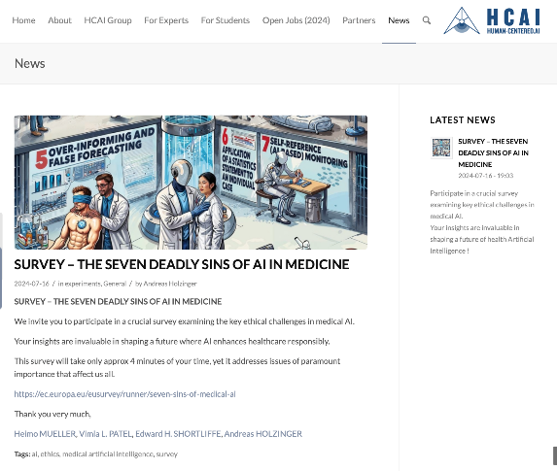
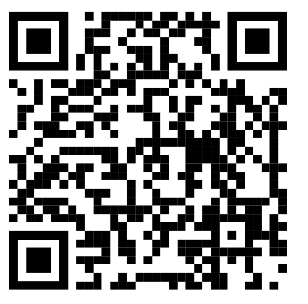
What do you think are the key ethical challenges in medical AI ?
This survey will take only approx 4 minutes of your time, lets do it together
https://ec.europa.eu/eusurvey/runner/seven-sins-of-medical-ai
https://human-centered.ai/7-sins-of-medical-ai

Slide 3
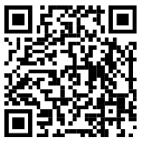
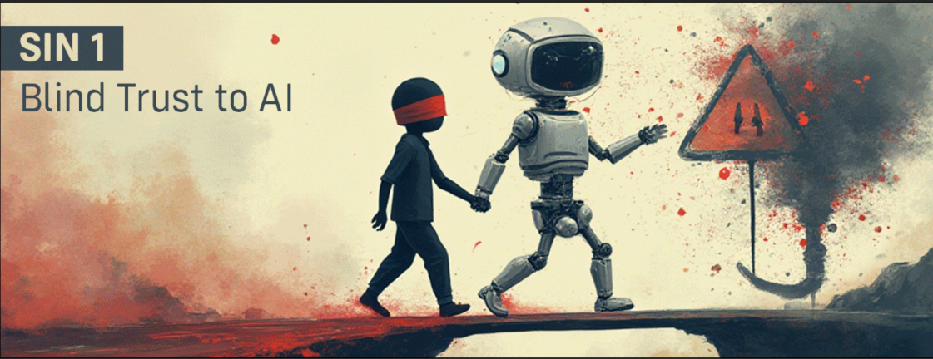
Sin 1 - Blind Trust to AI
Over-reliance on AI systems without adequate validation or verification can lead to incorrect or inappropriate decision making, that can even cause harm to humans.

Slide 4
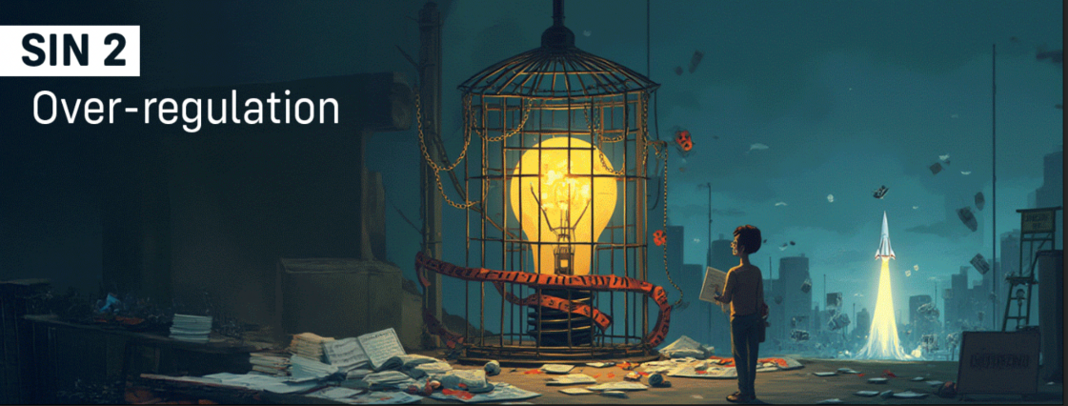
Sin 2 - Over-regulation (no guts, no glory)
Excessive regulation could prevent innovation and progress, and limit the ability of researchers and developers to experiment and take risks with new AI technologies.

Slide 5
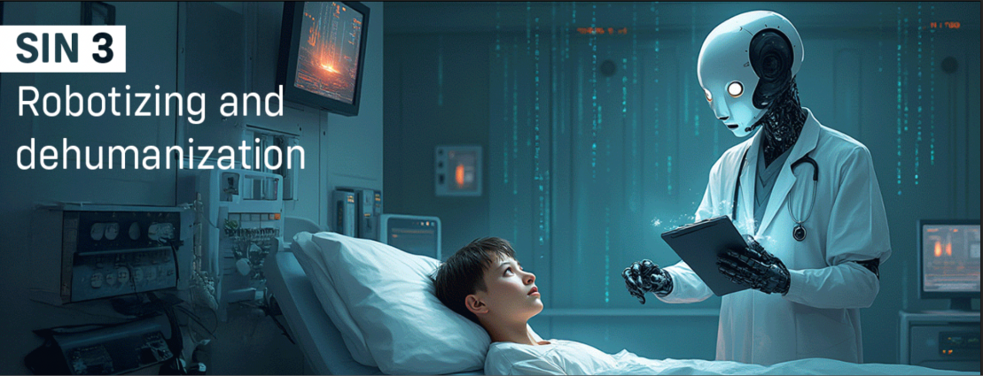
Sin 3 - Robotizing and dehumanization
AI systems that replace human interaction and compassion in the patient-doctor relationship can lead to a loss of empathy and decreased patient satisfaction.

Slide 6
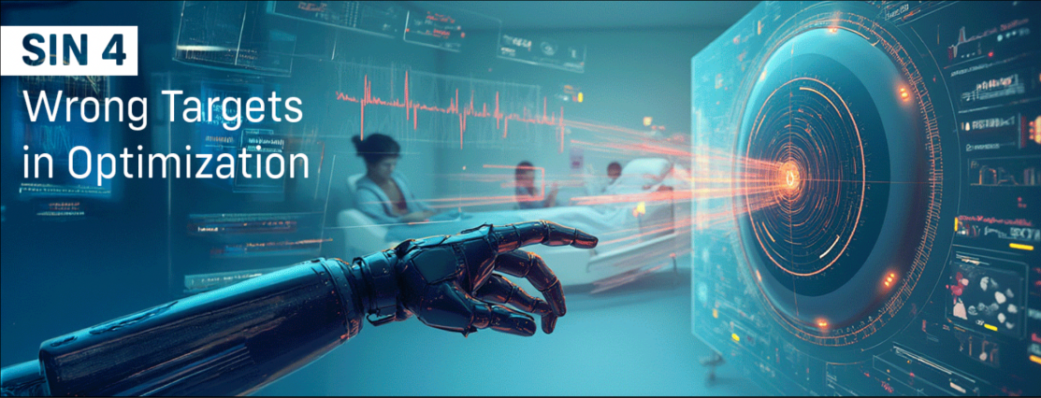
Sin 4 - Wrong targets in optimization
AI systems that prioritize metrics that do not align with overall patient outcomes can result in suboptimal decision making.

Slide 7
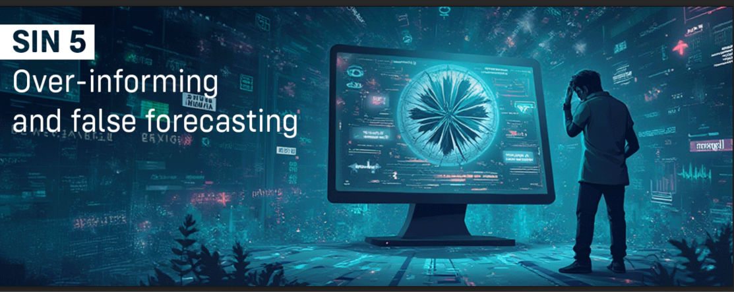
Sin 5 - Over-informing and false forecasting
AI systems that generate too much information or provide false predictions can lead to confusion and decreased trust in the technology.

Slide 8
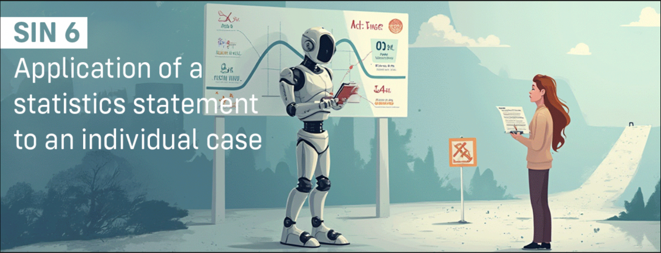
Sin 6 - Application of a statistics statement to an individual case
AI systems that rely solely on statistical models without considering individual patient circumstances can lead to incorrect or inappropriate decision making.

Slide 9
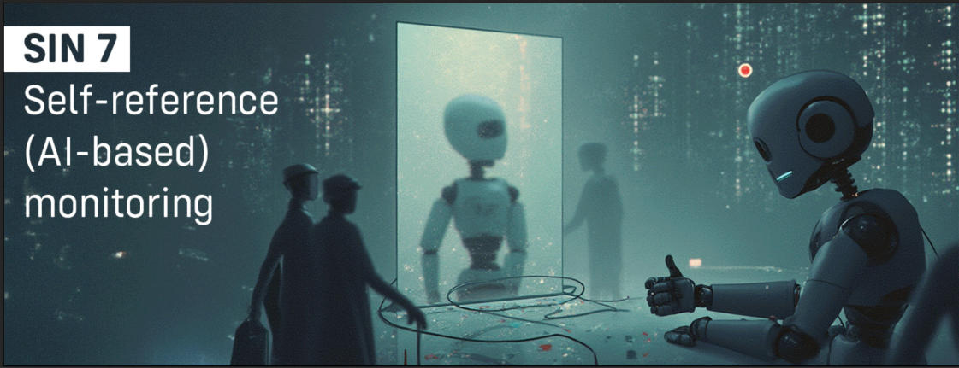
Sin 7 - Self-reference (AI-based) monitoring
AI systems that rely solely on themselves for evaluation, without independent oversight, can lead to a lack of accountability and decreased transparency in decision making.

Slide 10
Thank you very much!
You are contributing to a topic which affect us all!
https://human-centered.ai/7-sins-of-medical-ai

